Slide 1
PTAB Trial Proceedings
Tips from the Bench
October 16, 2014
The Honorable Brian Murphy (PTAB)
Louis W. Beardell, Jr. (Morgan Lewis & Bockius)
Michael F. Snyder (Volpe and Koenig)

Slide 2
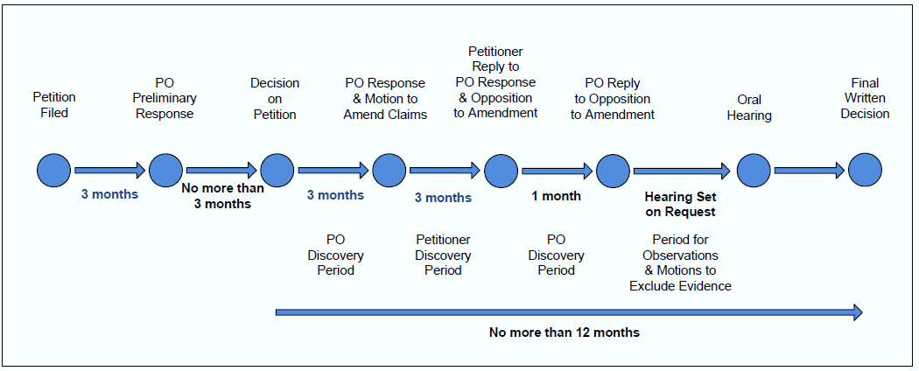
Trial Proceeding Timeline

Slide 3
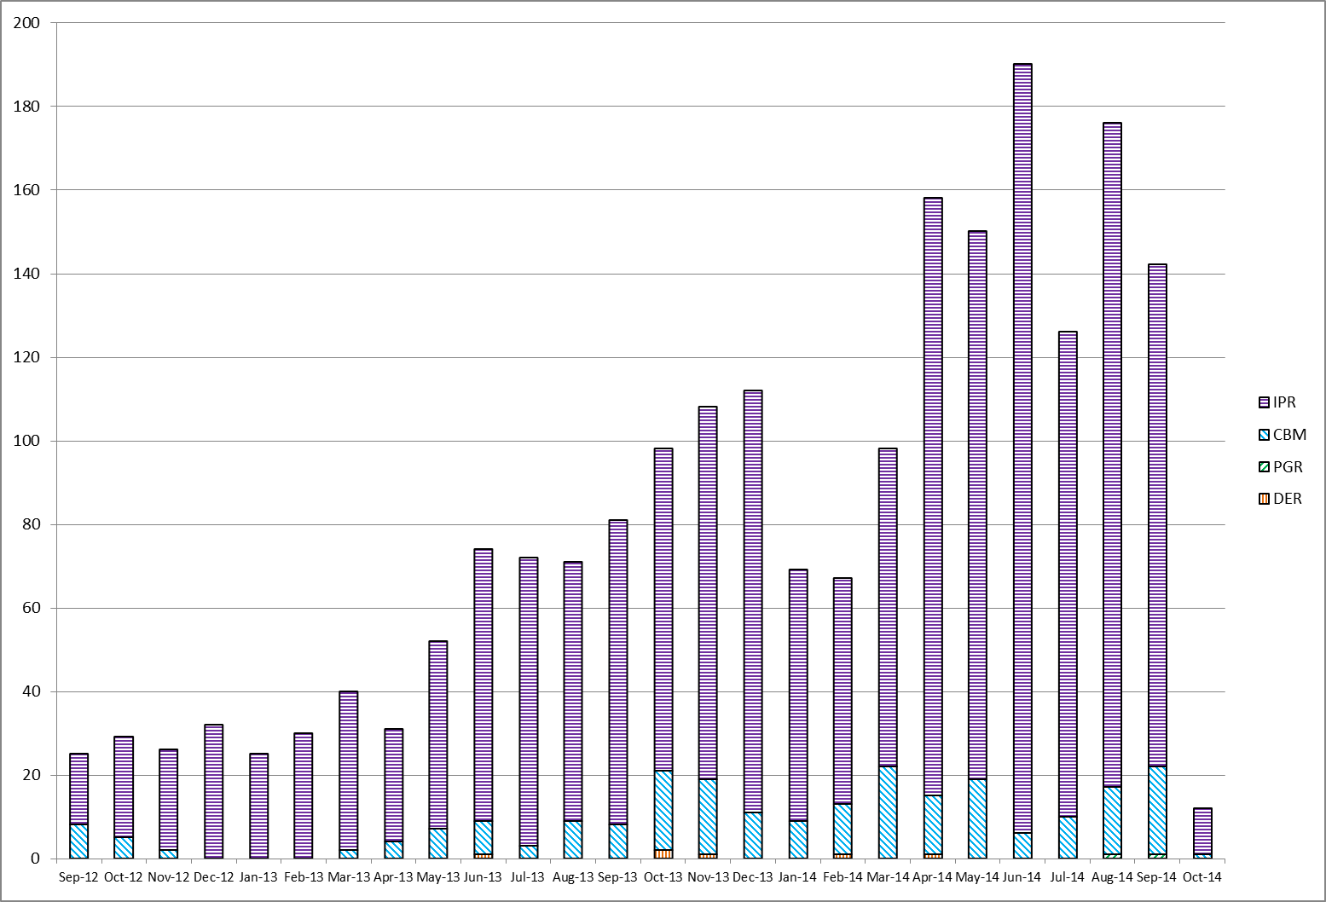
AIA Progress (as of October 2, 2014)
AIA Monthly Filings
Total | 2,094
IPR | 1,852
CBM | 234
PGR | 2
DER | 6

Slide 4
AIA Progress (as of October 2, 2014)
AIA Petition Technology Breakdown

Slide 5
AIA Progress (as of October 2, 2014)
Cumulative Patent Owner Preliminary Responses
 | Filed | Waived
IPR | 1,076 | 266
CBM | 149 | 20

Slide 6
AIA Progress (as of October 2, 2014)
AIA Petition Dispositions
 |  | Trials Instituted | Joinders | Percent Instituted | Denials | Total No. of Decisions on Institution
IPR | FY13 | 167 | 10⁺ | 87% | 26 | 203
 | FY14 | 557 | 15⁺ | 75% | 193 | 765
 | FY15 | 7 | 4⁺ | 73% | 4 | 15
CBM | FY13 | 14 | - | 82% | 3 | 17
 | FY14 | 77 | 1⁺ | 75% | 26 | 104
 | FY15 | 2 | - | 100% | - | 2
DER | FY14 | - | - | 0% | 3 | 3

Slide 7
Discovery
Discovery Period

Slide 8
AIA Progress (as of October 2, 2014)
AIA Final Dispositions
 |  | Settlements | Adverse Judgments | Final Written Decisions
IPR | FY13 | 38 | 2 | 0
 | FY14 | 210 | 39 | 130
 | FY15 | - | - | 1
CBM | FY13 | 3 | 0 | 1
 | FY14 | 27 | 3 | 13
 | FY15 | - | - | -

Slide 9
Settlements* (As of 6/18/2014)
CBM
IPR
* Pool is taken from 169 cases that have settled since inception.

Slide 10
Final Written Decisions:
Basis for Unpatentability (As of 6/18/2014)
CBM (11 decisions)
IPR (67 decisions)
* Multiple bases can be reported for a single Final Written Decision

Slide 11
Thank You

