Slide 2
Start-up, Investment Funding and IP; What Is the Best Option for Your Company (or Your Client)?
PA and DE sign up sheets are circulating
If you are NY or NJ, please sign PA sheet
Please fill out an evaluation form

Slide 3
Start-up, Investment Funding and IP; What Is the Best Option for Your Company (or Your Client)?
John O’Malley - Moderator
Mark Roderick – Crowdsourcing
Paul Mitchell – Banking
Valerie Gaydos – Angel Funding
Wayne Kimmel – Venture Capital

Slide 5
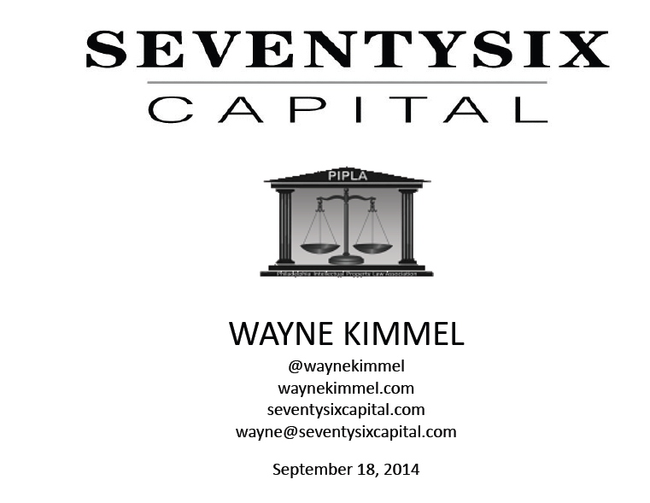

Slide 8
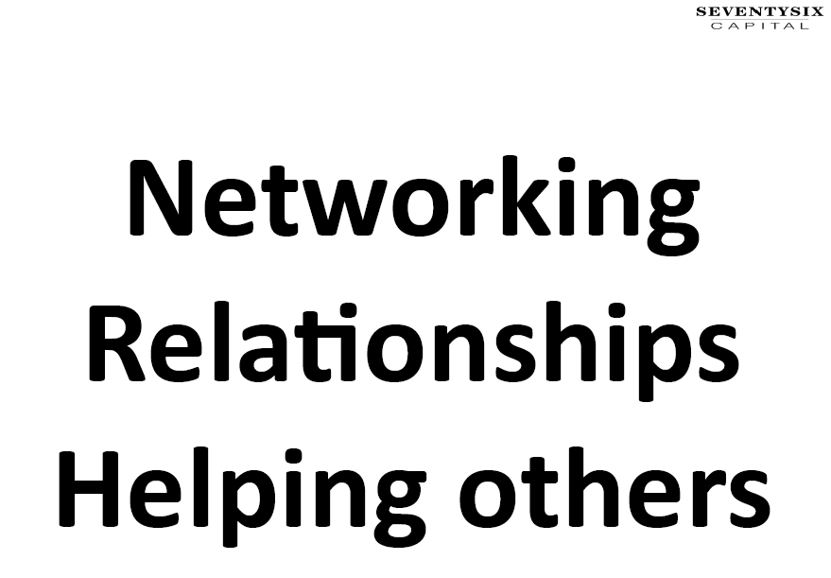

Slide 12
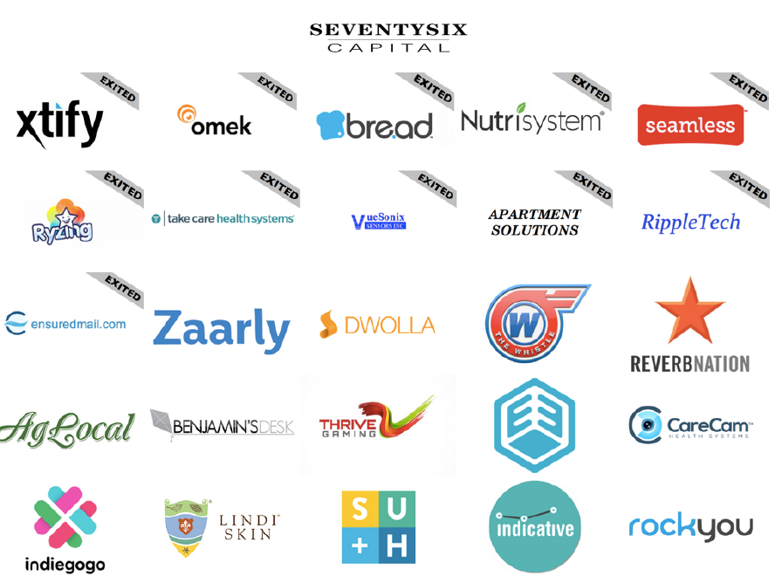

Slide 13
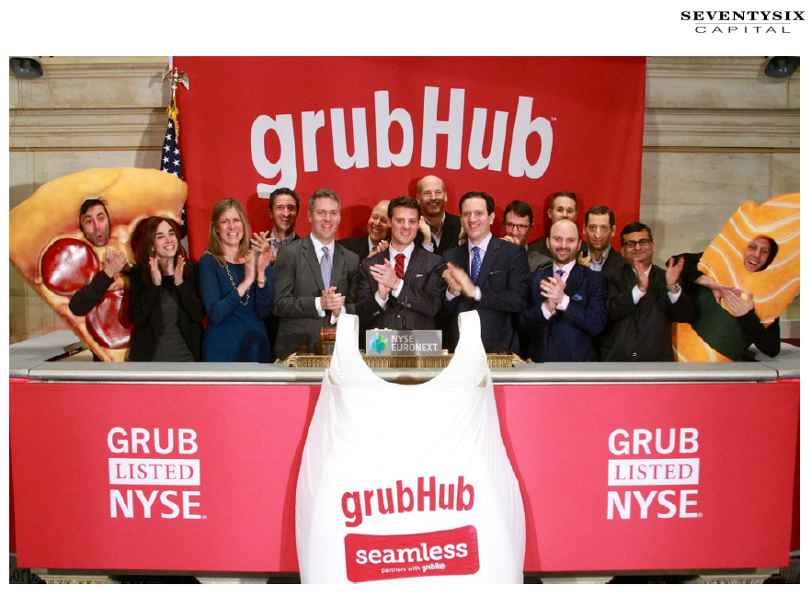

Slide 15
2014-2015 Program Schedule
Meeting Date Topic
October 16, 2014 An Update From and ALJ at the USPTO Patent Trial and Appeal Board
November 19, 2014 Judges’ Dinner at The Barnes Foundation Honoring Hon. Gregory M. Sleet, U.S. District Judge for the District of Delaware,
January 15, 2015 An Update from the Copyright Office
February 19, 2015 Trademarks in the Wine Industry (plus a wine tasting)

Slide 16
New PIPLA Benefit
With our booking of the Judges’ Dinner at the Barnes Foundation we get a corporate membership
Limited number (50) free tickets
Two private tours with a docent with up to 15 guests
Discounts in the store and restaurant
Discounts for other event bookings
Contact Jay Halt if you would like to take advantage
of any of these benefits.

Slide 17
Please return sign in sheets and evaluation forms

